Slide 1
Medicaps University
Supervised and Unsupervised Learning

Slide 2
Supervised Learning
Supervised learning, as the name indicates, has the presence of a supervisor as a teacher.
Basically supervised learning is when we teach or train the machine using data that is well labelled.
Which means some data is already tagged with the correct answer.
After that, the machine is provided with a new set of examples(data) so that the supervised learning algorithm analyses the training data(set of training examples) and produces a correct outcome from labelled data.

Slide 3
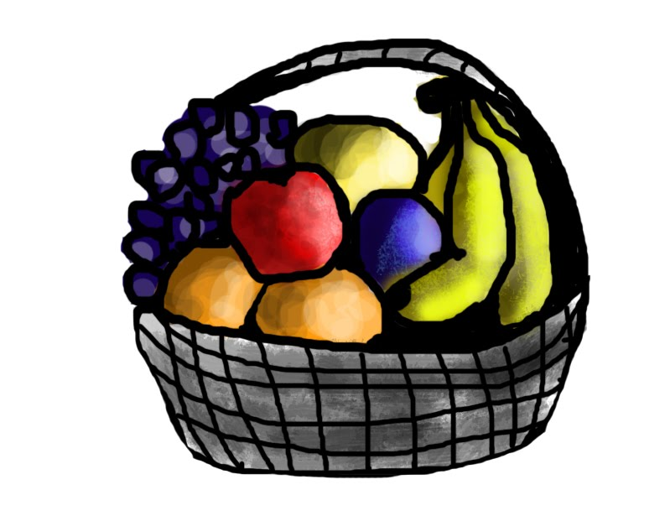
For instance, suppose you are given a basket filled with different kinds of fruits.
Now the first step is to train the machine with all the different fruits one by one like this:

Slide 4
If the shape of the object is rounded and has a depression at the top, is red in color, then it will be labeled as –Apple.
If the shape of the object is a long curving cylinder having Green-Yellow color, then it will be labeled as –Banana.

Slide 5

Now suppose after training the data, you have given a new separate fruit, say Banana from the basket, and asked to identify it.

Slide 6
Since the machine has already learned the things from previous data and this time has to use it wisely.
It will first classify the fruit with its shape and color and would confirm the fruit name as BANANA and put it in the Banana category.
Thus the machine learns the things from training data(basket containing fruits) and then applies the knowledge to test data(new fruit).

Slide 7
Supervised learning is classified into two categories of algorithms:
Classification: A classification problem is when the output variable is a category, such as “Red” or “blue” , “disease” or “no disease”.
Regression: A regression problem is when the output variable is a real value, such as “dollars” or “weight”.
Supervised learning deals with or learns with “labeled” data. This implies that some data is already tagged with the correct answer.

Slide 8
Types
Regression
Logistic Regression
Classification
Naive Bayes Classifiers
K-NN (k nearest neighbors)
Decision Trees
Support Vector Machine

Slide 9
Advantages
Supervised learning allows collecting data and produces data output from previous experiences.
Helps to optimize performance criteria with the help of experience.
Supervised machine learning helps to solve various types of real-world computation problems.

Slide 10
Disadvantages
Classifying big data can be challenging.
Training for supervised learning needs a lot of computation time. So, it requires a lot of time.

Slide 11
Unsupervised Learning
Unsupervised learning is the training of a machine using information that is neither classified nor labeled and allowing the algorithm to act on that information without guidance.
Here the task of the machine is to group unsorted information according to similarities, patterns, and differences without any prior training of data.
Unlike supervised learning, no teacher is provided that means no training will be given to the machine.
Therefore the machine is restricted to find the hidden structure in unlabeled data by itself.

Slide 12
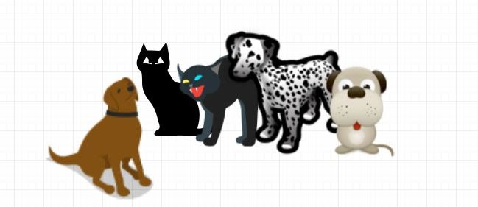
For instance, suppose it is given an image having both dogs and cats which it has never seen.

Slide 13
Thus the machine has no idea about the features of dogs and cats so we can’t categorize it as ‘dogs and cats ‘. But it can categorize them according to their similarities, patterns, and differences, i.e., we can easily categorize the above picture into two parts.
The first may contain all pics having dogs in them and the second part may contain all pics having cats in them.
Here you didn’t learn anything before, which means no training data or examples.

Slide 14
It allows the model to work on its own to discover patterns and information that was previously undetected.
It mainly deals with unlabelled data.

Slide 15
Unsupervised learning is classified into two categories of algorithms:
Clustering: A clustering problem is where you want to discover the inherent groupings in the data, such as grouping customers by purchasing behavior.
Association: An association rule learning problem is where you want to discover rules that describe large portions of your data, such as people that buy X also tend to buy Y.

Slide 16
Types of Unsupervised Learning
Clustering
Exclusive (partitioning)
Agglomerative
Overlapping
Probabilistic
Clustering Types:-
Hierarchical clustering
K-means clustering
Principal Component Analysis
Singular Value Decomposition
Independent Component Analysis

Slide 17
Supervised vs. Unsupervised Machine Learning
Parameters | Supervised machine learning | Unsupervised machine learning
Input Data | Algorithms are trained using labeled data. | Algorithms are used against data that is not labeled
Computational Complexity | Simpler method | Computationally complex
Accuracy | Highly accurate | Less accurate
No. of classes | No. of classes is known | No. of classes is not known
Data Analysis | Uses offline analysis | Uses real-time analysis of data
Algorithms used | Linear and Logistics regression, Random forest, Support Vector Machine, Neural Network, etc. | K-Means clustering, Hierarchical clustering, Apriori algorithm, etc.

